Slide 1
Tailwind css

Slide 2
using tailwindcss with cdn

Slide 3
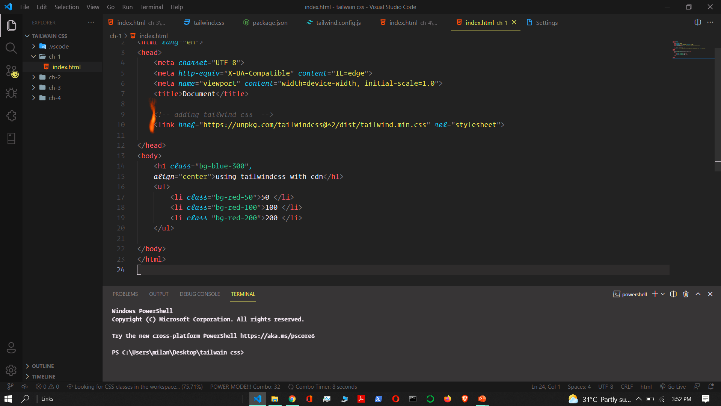

Slide 4
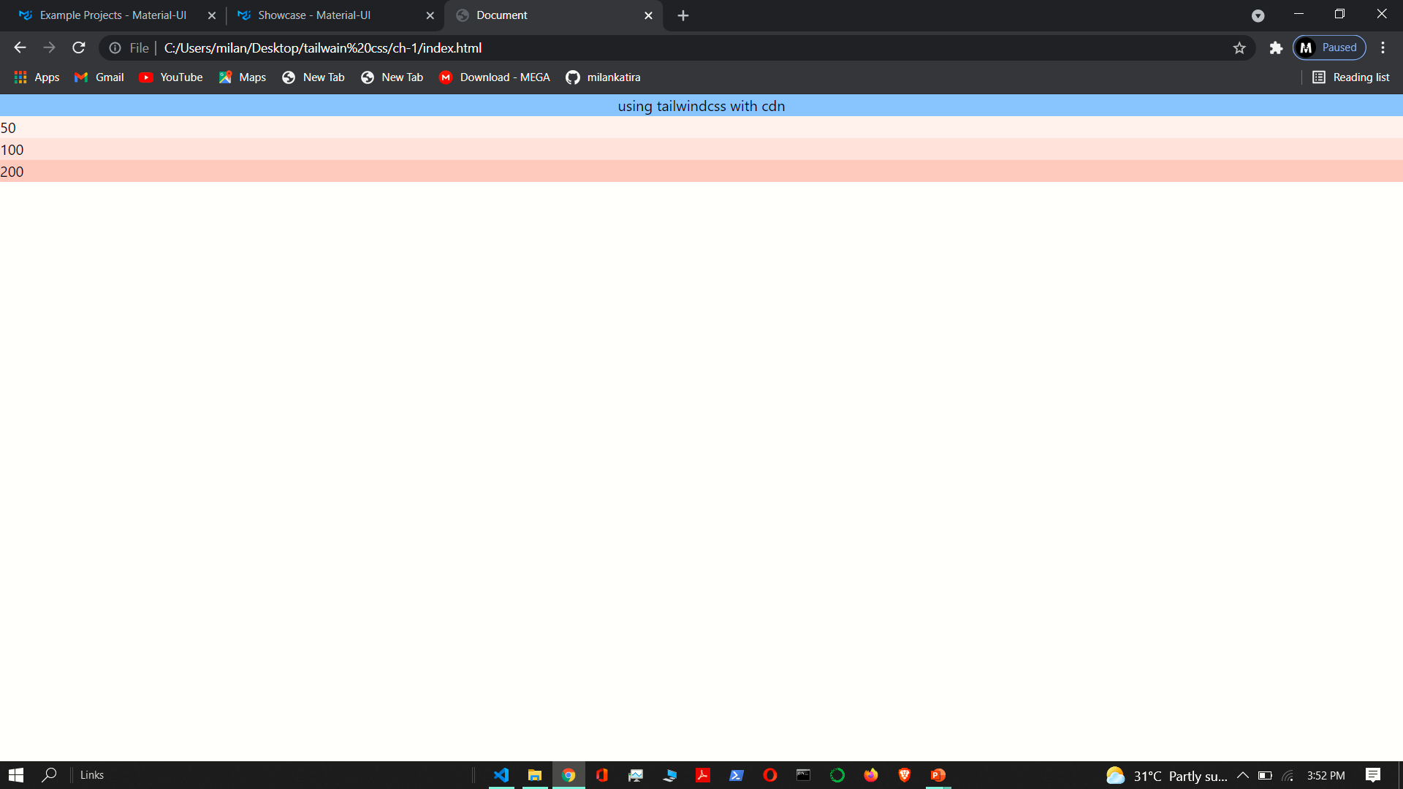

Slide 5
using Tailwind as a without PostCSS plugin

Slide 6
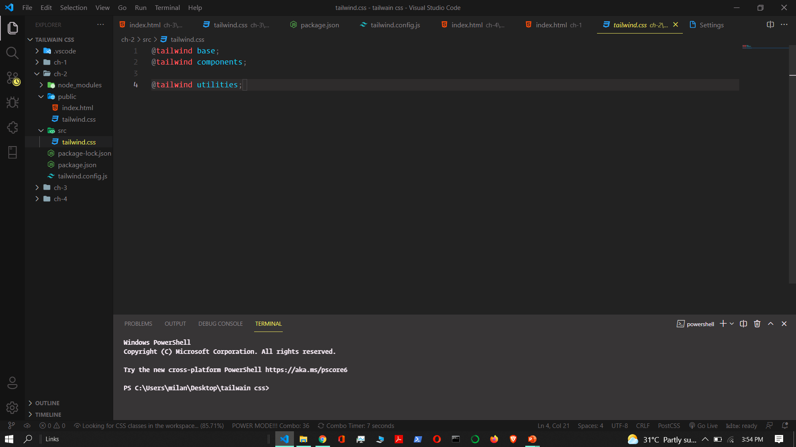
Adding tailwind css

Slide 7
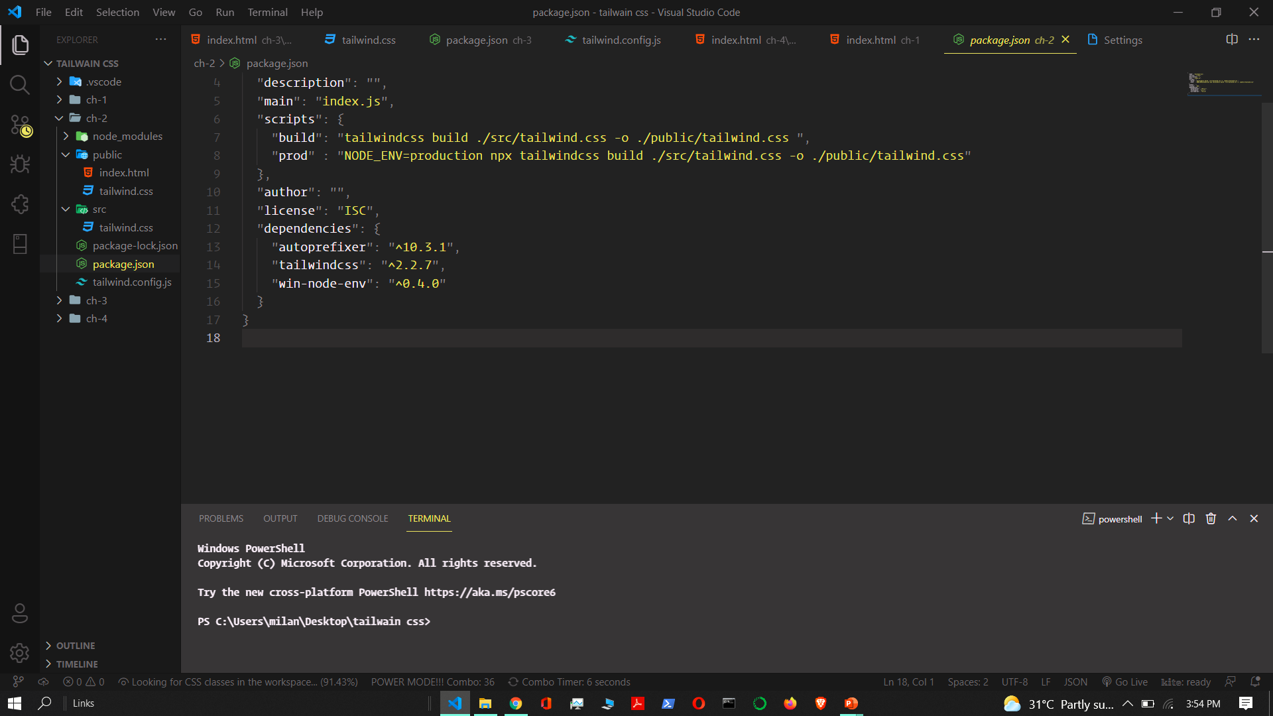
dependencies

Slide 8
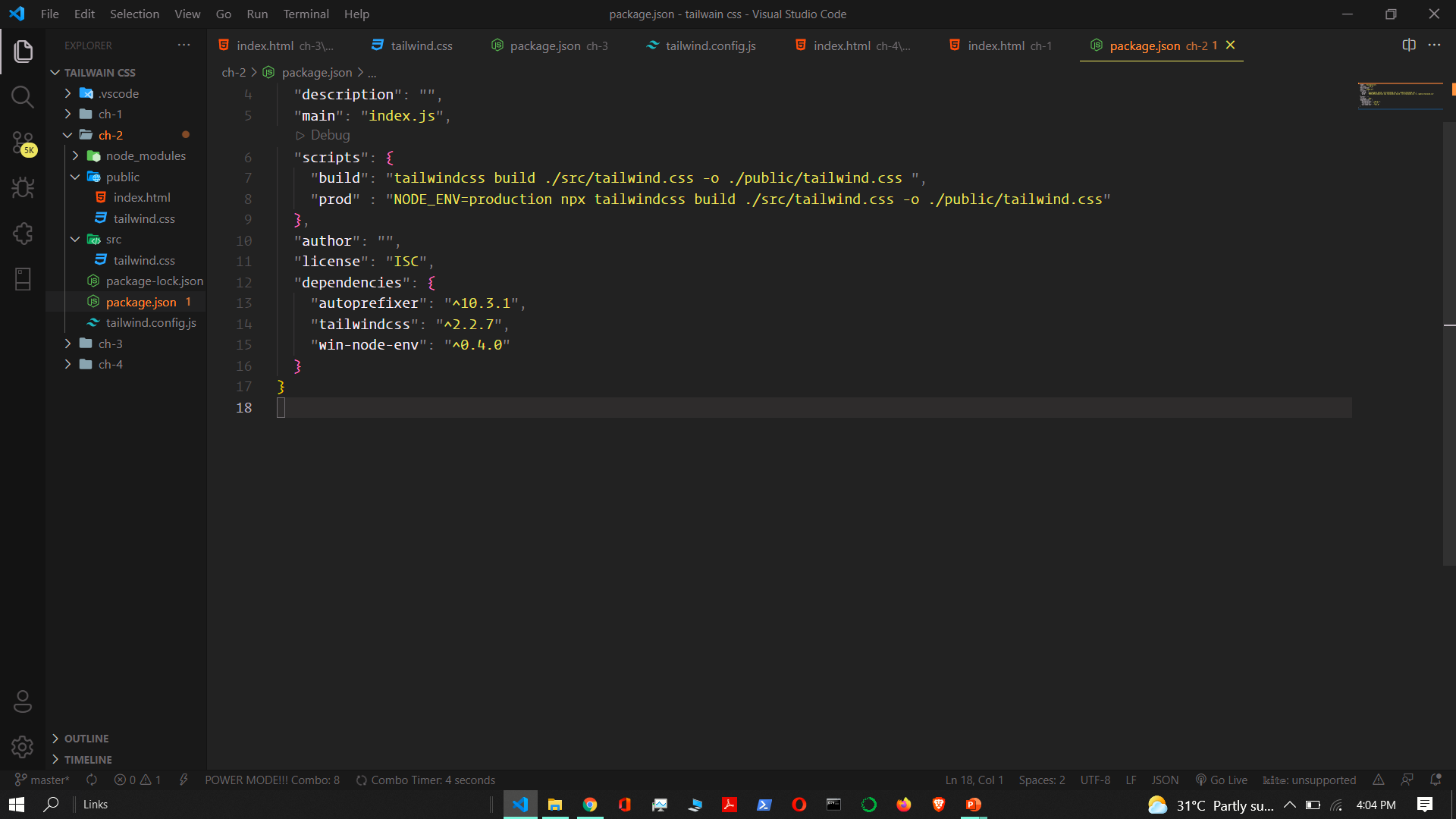

Build is used to add src/tailwind.css to public/tailwind.css
And
Prob is used to size reduce and remove extra css from public/tailwind.css

Slide 9
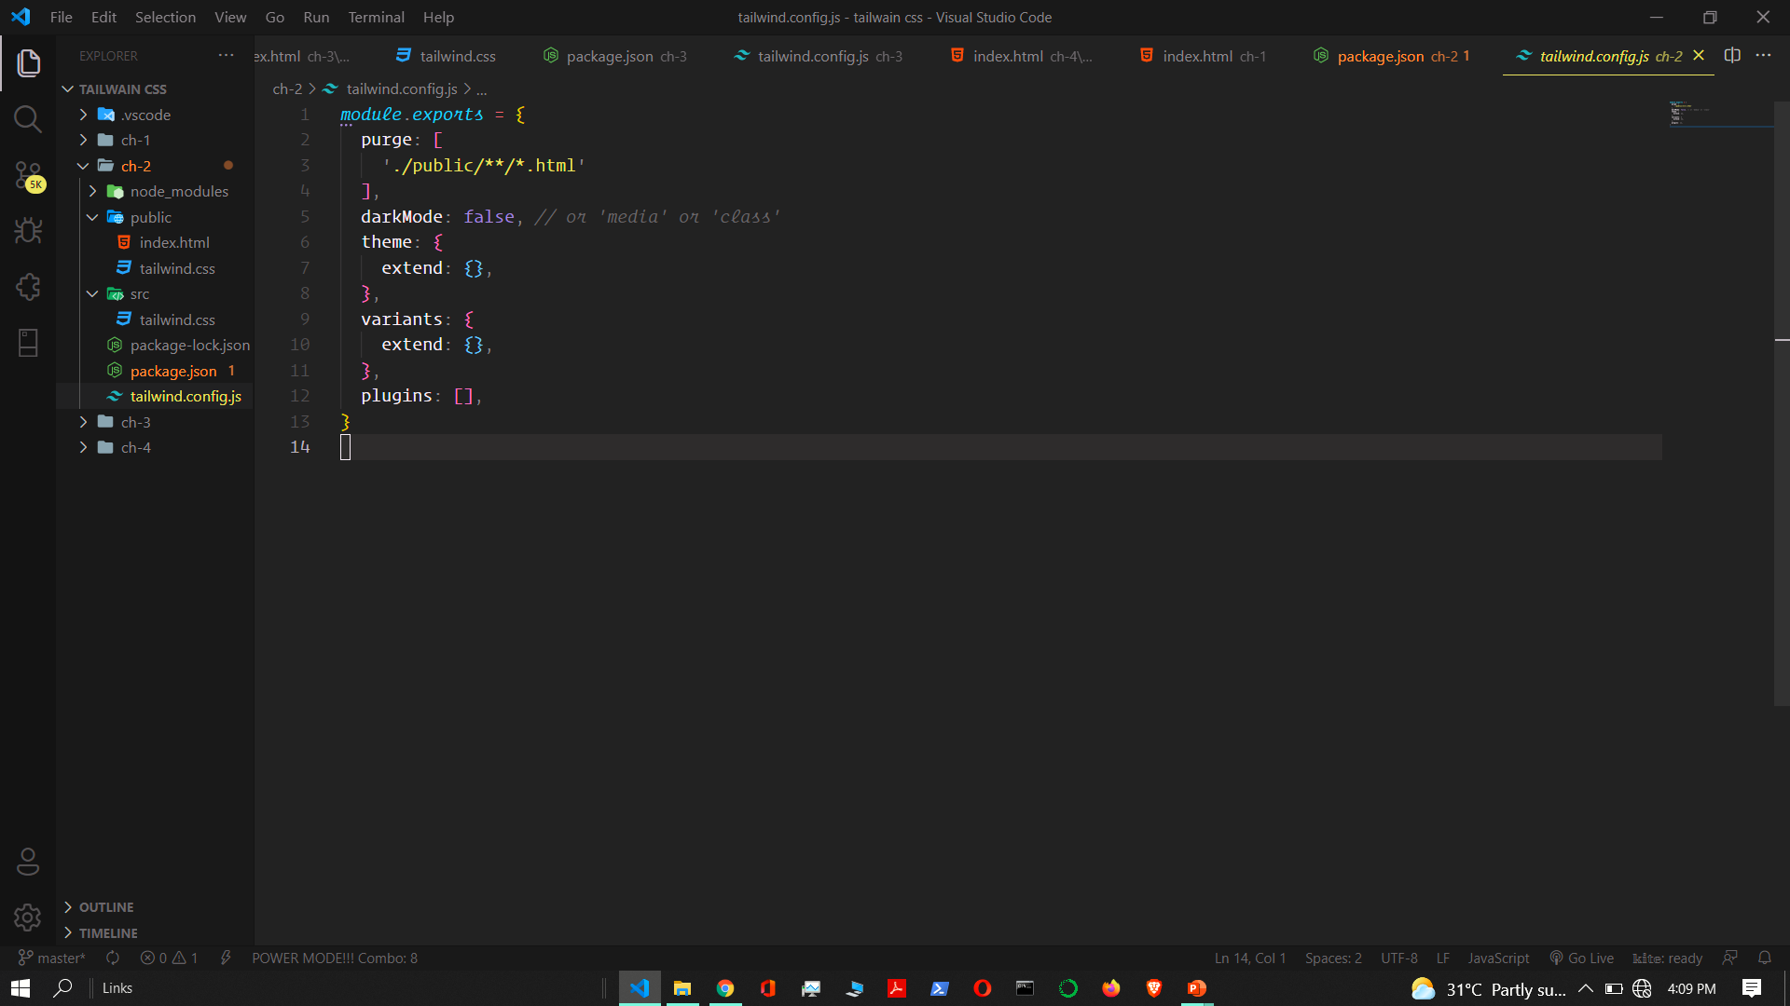

Slide 10


Slide 11
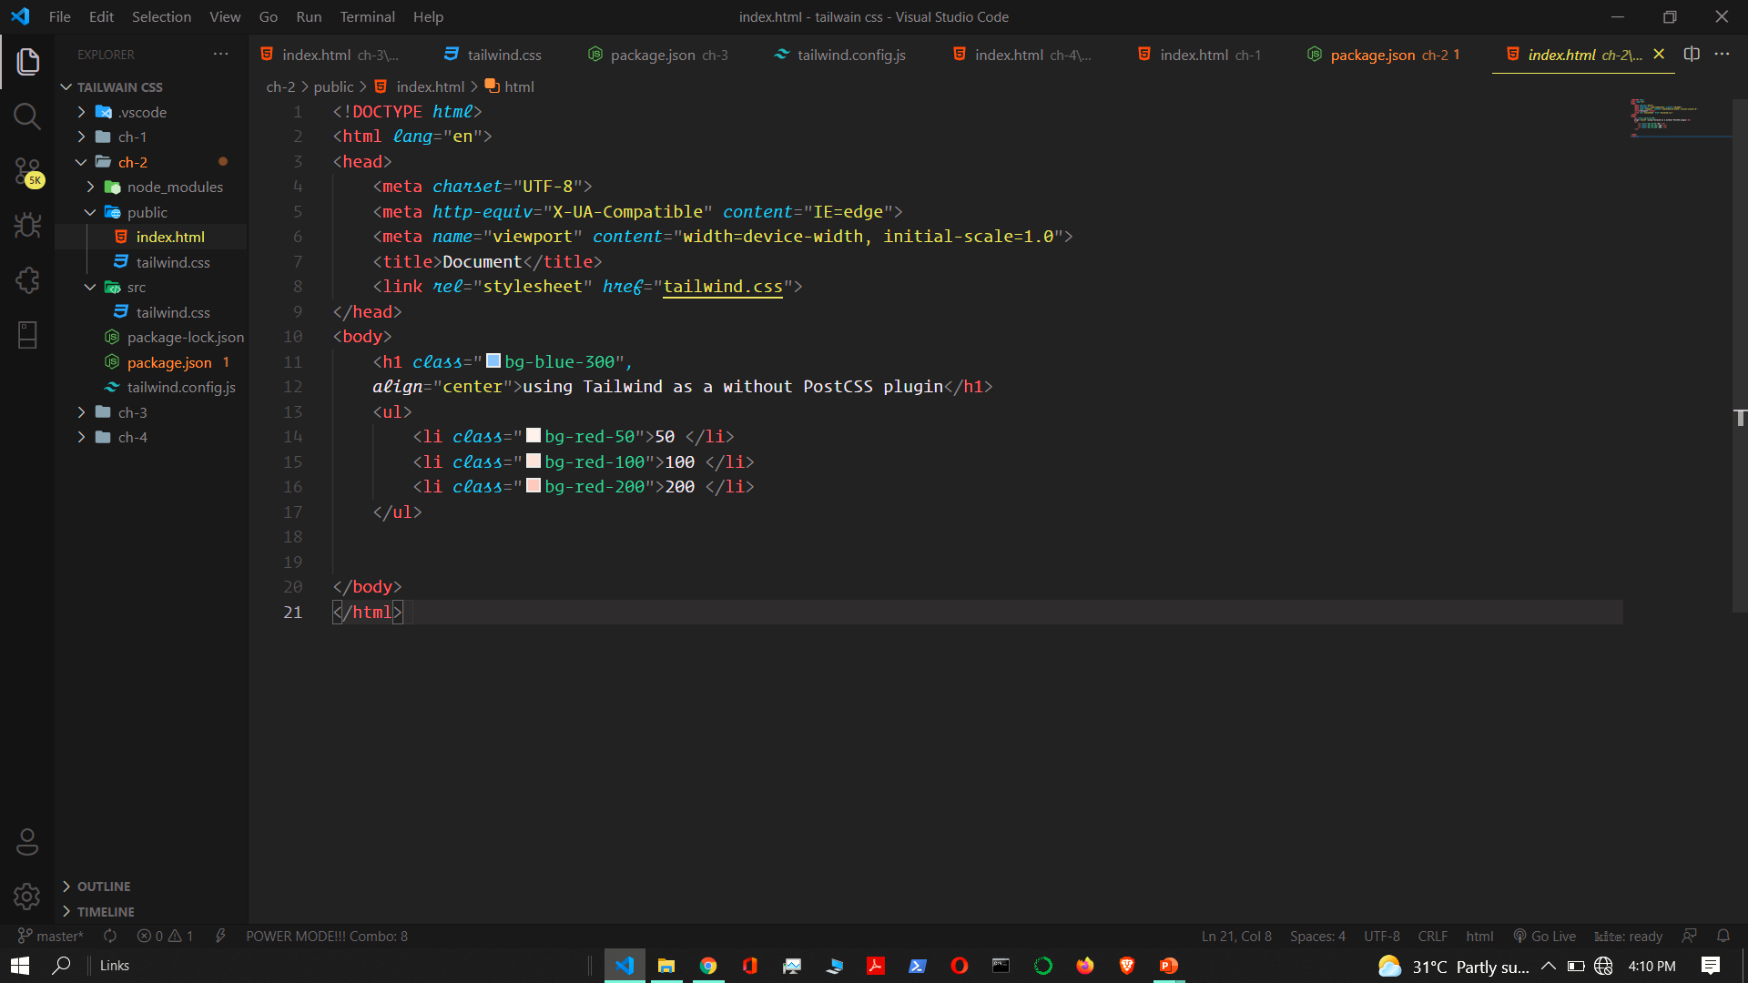

Slide 12
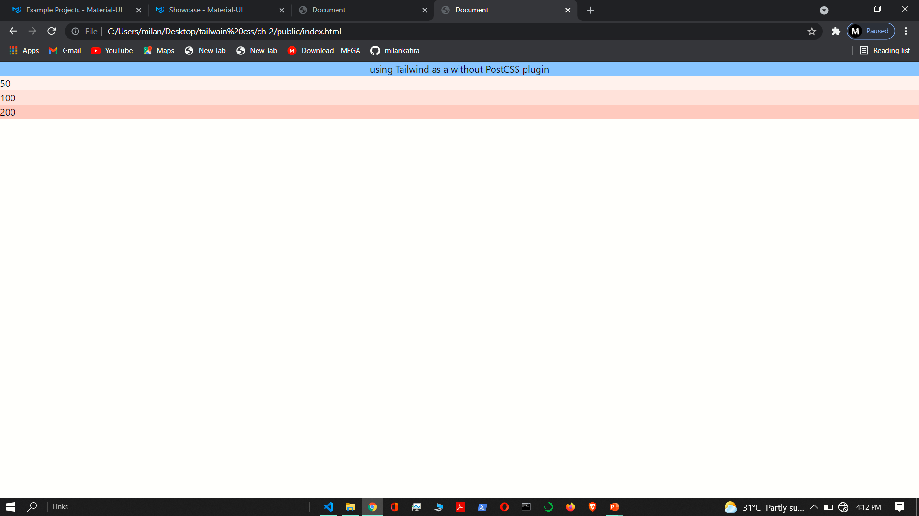

Slide 13
using Tailwind as a PostCSS plugin

Slide 14
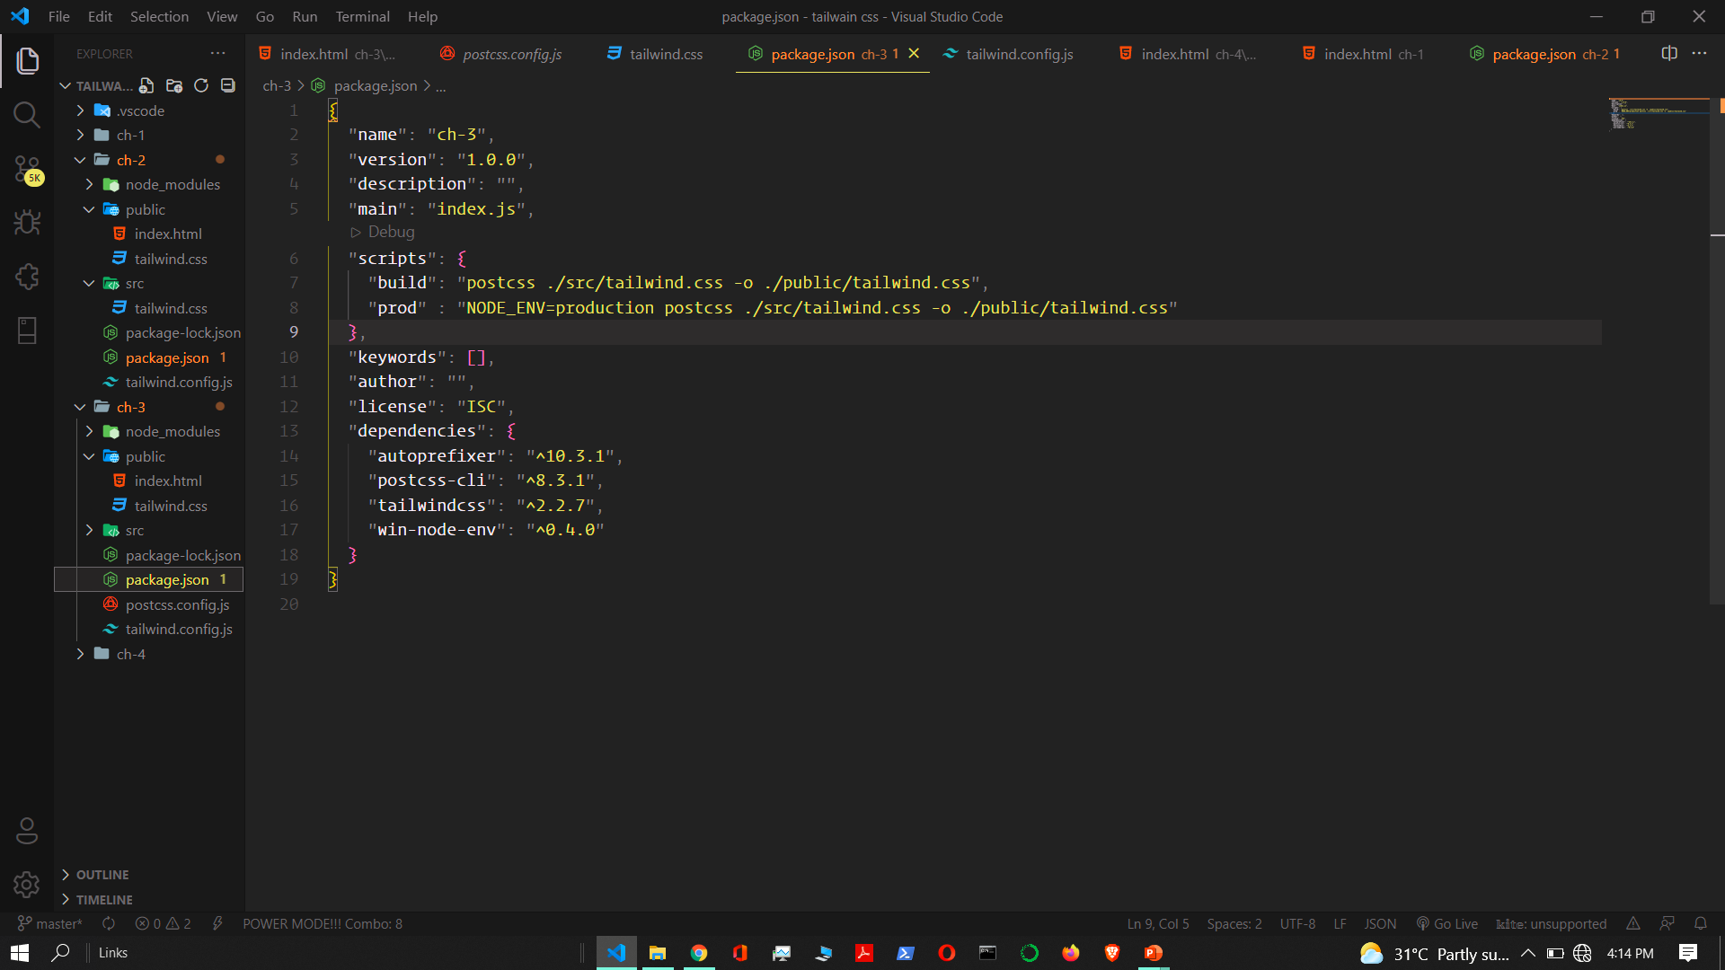

Slide 15
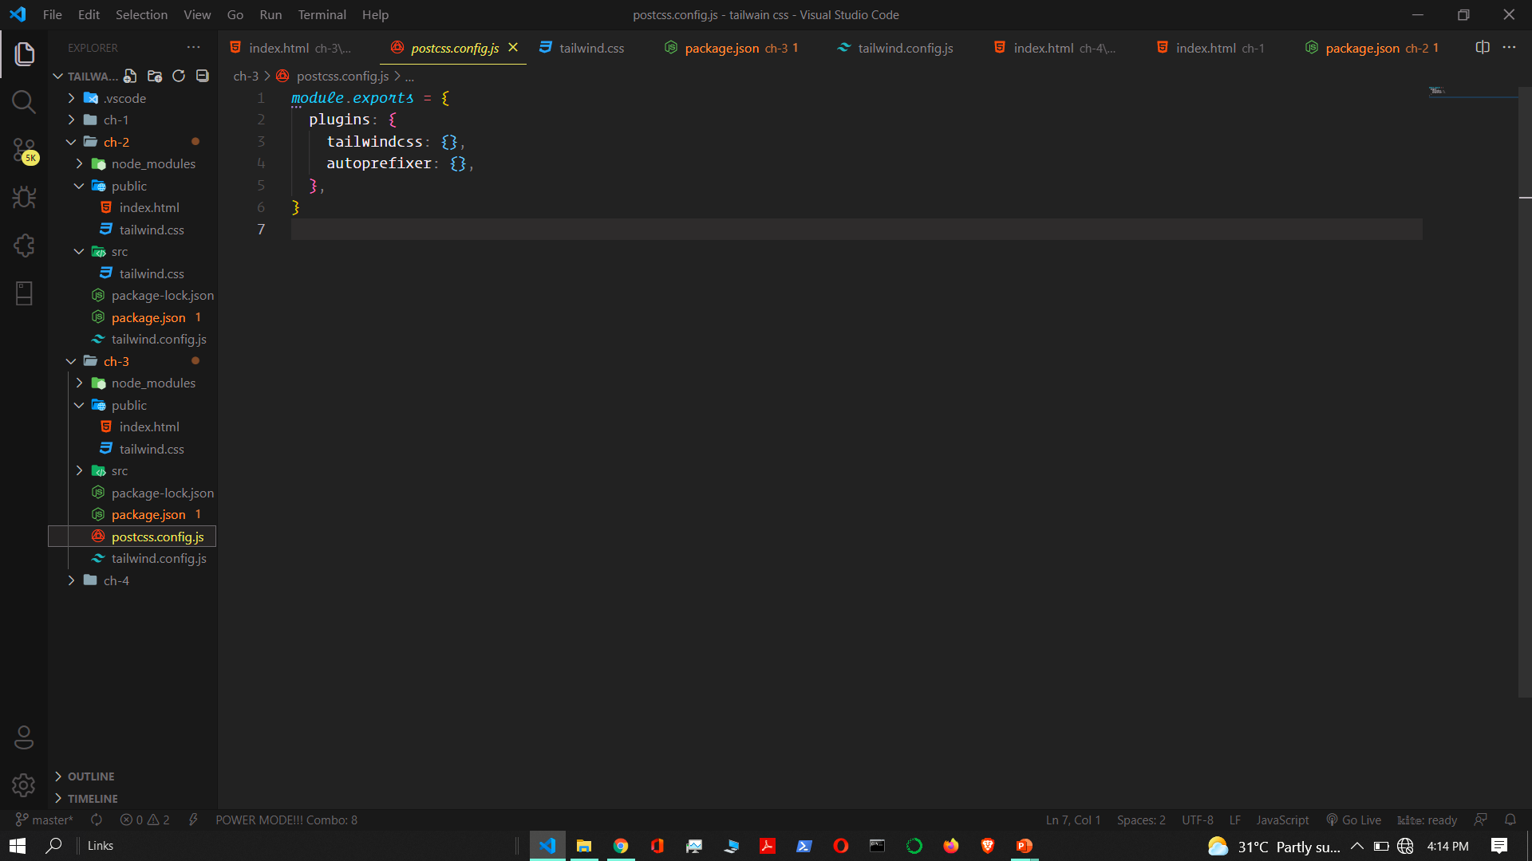

Slide 16
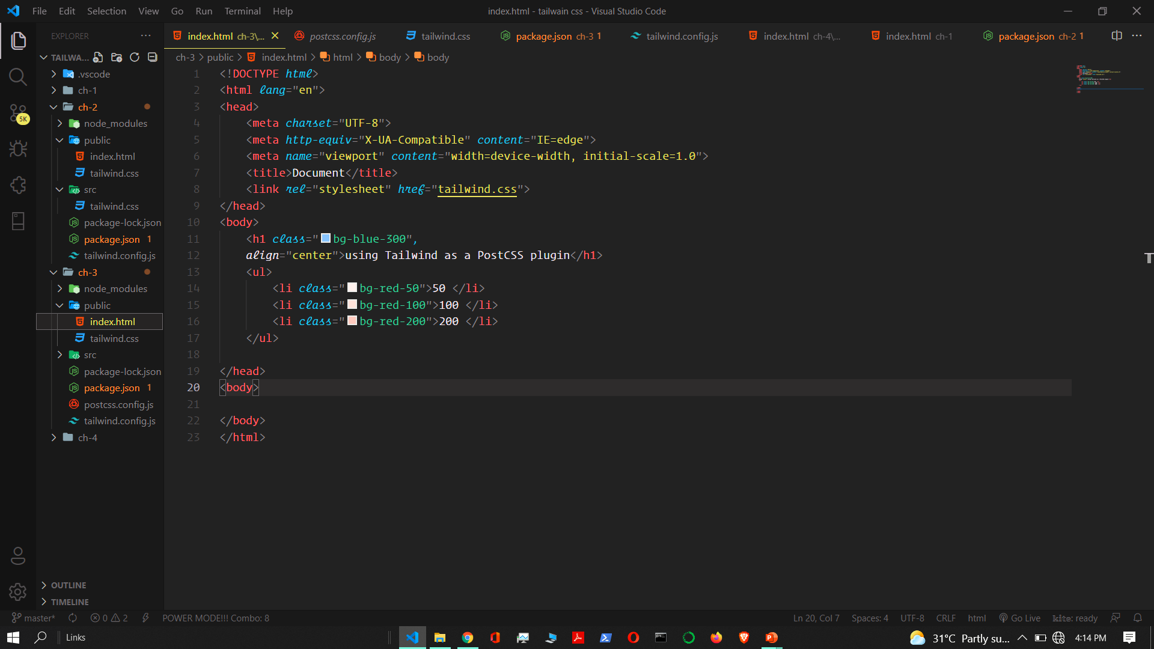

Slide 17
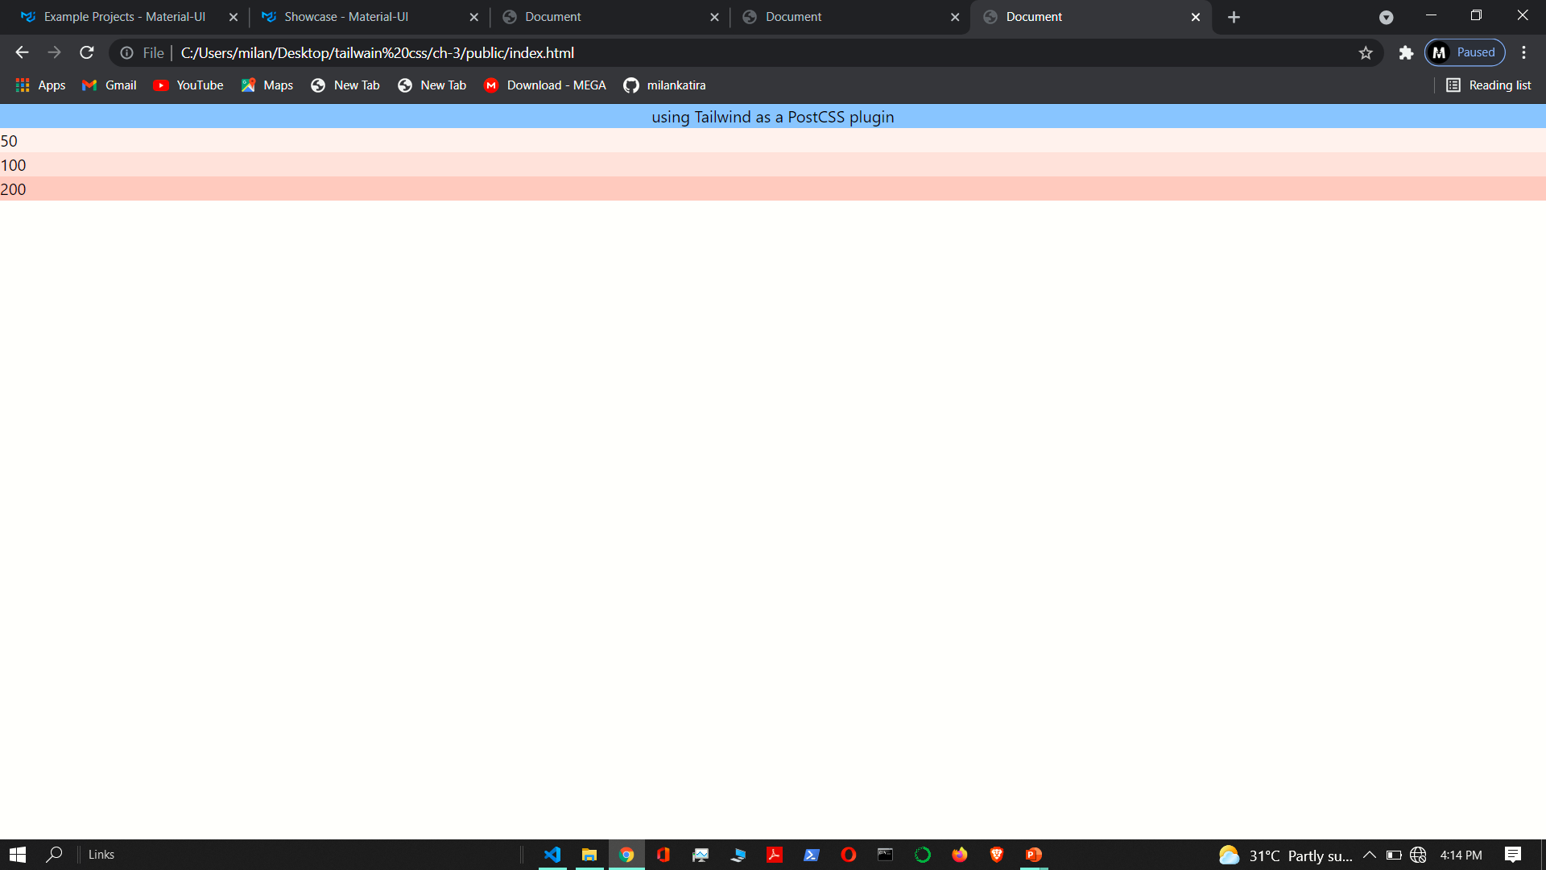

Slide 18
